Slide 1
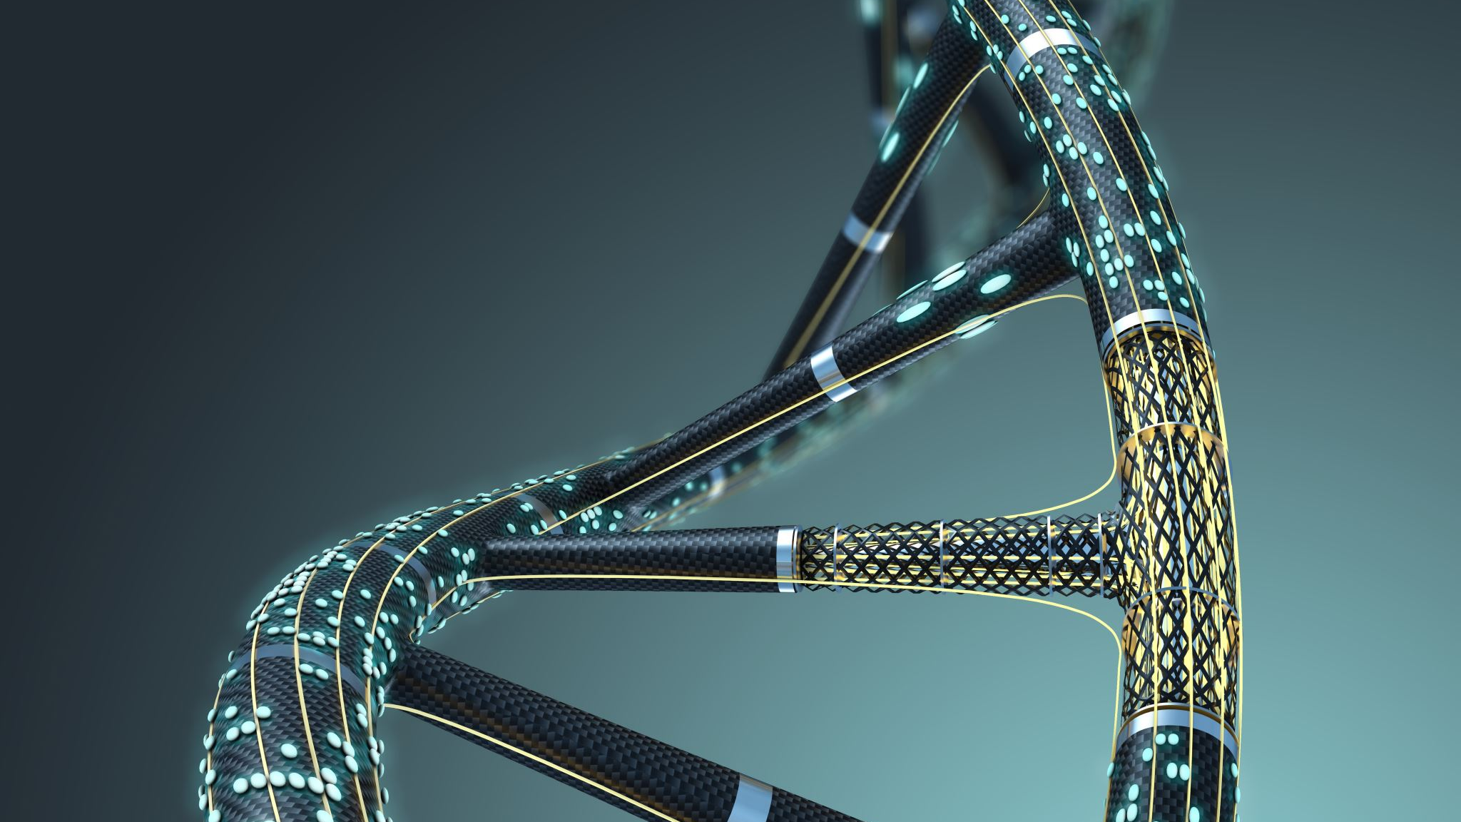
Visualization of the Global Genome Structure
Ishaku Lemu Haruna

Slide 2
Introduction
We are similar, yet different!
These variations are observed across different individuals in different continents.
It is therefore important to understand the different components responsible for these variations across populations.
Principle components analysis (PCA) is used to identify population structure.
Justification
One of the major challenges in human genetics today is the ability to precisely predict whether an individual will have a particular trait via genetic association studies. To effectively achieve this, it is important to identify population structure and/or infer ancestry differences among individuals from different populations. In this context, a project such as this becomes highly significant as it aims to identify the factors responsible for these variations.

Slide 3
Aim and objectives
The main aim of this project was to visually represent the diversity of the global genome and to identify the components responsible for this diversity….
Objective
To determine what principal component is responsible for the variation in the data investigated

Slide 4
Methodology
Methodology
Eigenval
eigenvec and eigenval files were generated in bash using the command line:
Files
Files transfer:
Rstudio
install.packages("ggplot2")
ggplot
Plot
To set the working directory:
PCA1
eigenval = read.table("plink.eigenvec", header = F)
ggplot(data=IshakuFinaldata, aes(V3,V4,color = Superpopulation.code)) + geom_point()
plink --bfile 1_1-150000 --pca
scp -P 10497 -r genomics@6.tcp.eu.ngrok.io:/home/genomics/Ishaku $PWD
setwd("/cloud/project/Ishaku/Ishaku/Ishaku")
library("ggplot2")
head(eigenval)
complete = read.table("complete_1000_genomes_sample_list_.tsv", header = T,sep = '\t')
head(complete)
IshakuFinaldata = merge(eigenval,complete, by.x = "V2", by.y = "Sample.name",all = F)
To merge the eigenval and complete 1000 genomes sample together
View(eigenval)
View(complete)

Slide 5
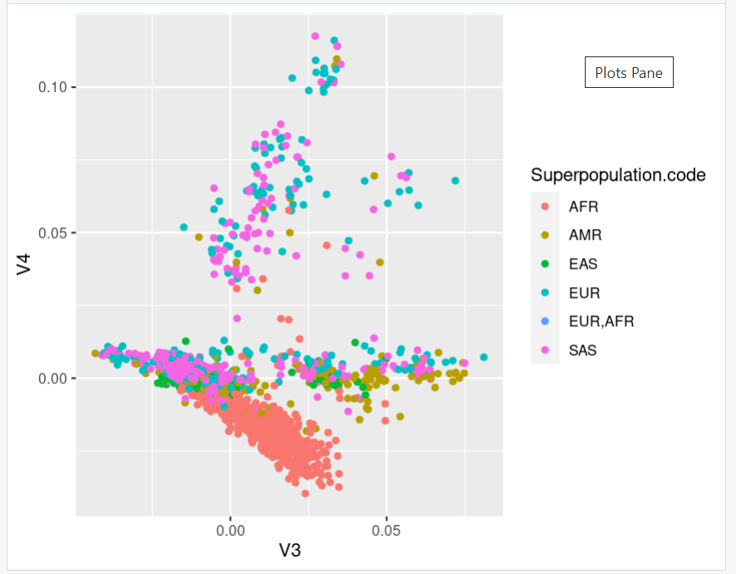
Results and Discussion
ggplot

Slide 6
Conclusion
V3 (PC1) accounts for the largest possible variance in the data set investigated
Points with similar colours (as observed in the super population code (AFR) clustered together indicates that they are highly correlated

Slide 7
References
Final_Projects_genomics - Google Slides
Workshop 6: Analysis of population structure. (york.ac.uk)
public_datasets/Global_genome_structure_project at main · HackBio-Internship/public_datasets (github.com)

